Slide 1
Capstone Project – The Battle of Neighborhoods
Applied Data Science Capstone
by IBM
on coursera

Slide 2
Introduction
Business problem: find the most profitable location to open a pizzeria in Scarborough, Toronto, Canada
Interested parties: Luigi and his family, who would like to open a pizzeria near their house in Scarborough.

Slide 3
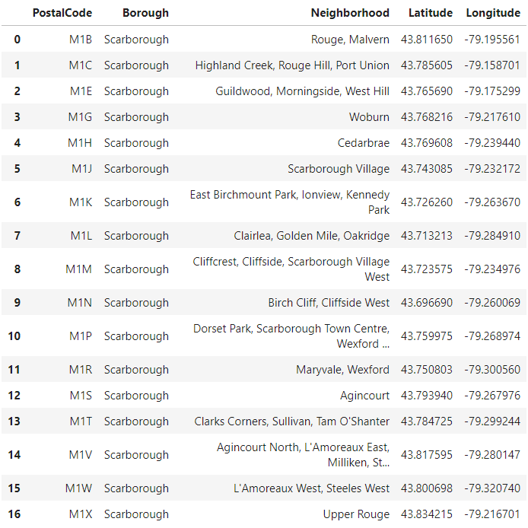
Data
Raw data present postal codes, neighborhoods and geographical location of Scarborough.

Slide 4
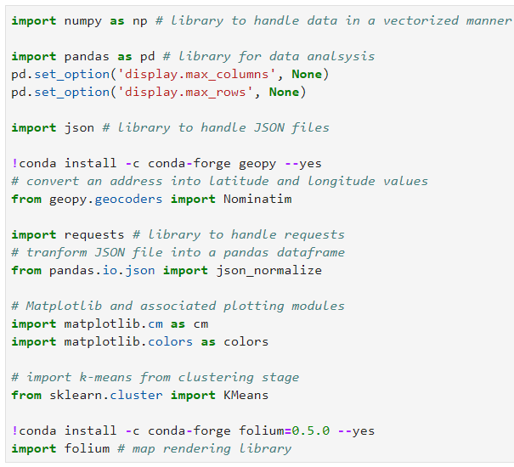
Methodology
Following libraries were installed for data analysis

Slide 5
Methodology
Neighborhoods in Scarborough where explored using Foursquare API with following URL and Foursquare API version:
url: 'https://api.foursquare.com/v2/venues/explore?client_id={}&client_secret={}&ll={},{}&v={}&radius={}&limit={}'.format (CLIENT_ID, CLIENT_SECRET, latitude, longitude, VERSION, radius, LIMIT)
version: '20180605'

Slide 6
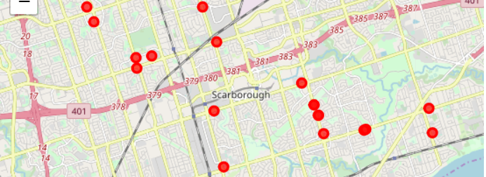
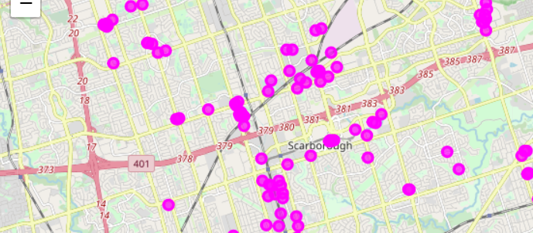
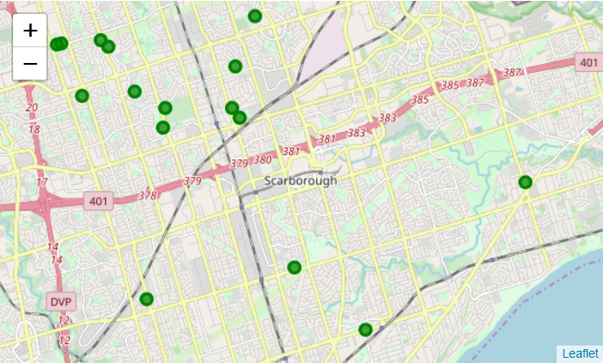
Methodology
Following approaches were done to find the most profitable location of a pizzeria:
# Use category id 4bf58dd8d48988d1ca941735 to only find pizzerias in Scarborough
# Use category id 4bf58dd8d48988d13d941735 to only find high schools in Scarborough, since students are good customers
# Use category id 4bf58dd8d48988d124941735 to only find offices in Scarborough, since employees are good customers.

Slide 7
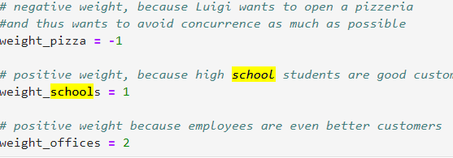
Methodology
Following approaches were done to find the most profitable location of a pizzeria:
# Number of pizzerias, high schools and offices were summed up per neighborhood and weighted according to the following sheme:

Slide 8
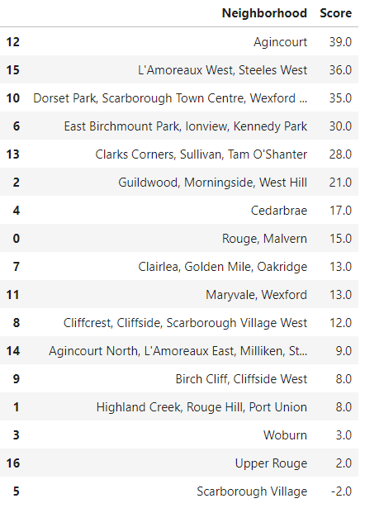
Results
Sums of each category were multiplied with weights to generate following table, which summarizes the best locations in Scarborough to open a pizzeria. Agincourt presents the highest score of neighborhoods in Scarborough.

Slide 9
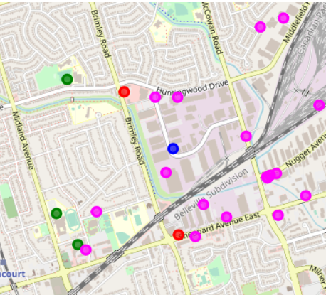
Results
Following maps shows the neighborhood of Agincourt (blue) with existing pizzerias (red), high schools (green) and offices (fuchsia).

Slide 10
Discussion
Further analysis can be done on the second and third ranking neighborhood in Scarborough to find alternative spots that might be lucrative but also more close to Luigis home.
The data analysis can be improved with following extensions:
Consider more categories, e.g. Nightlife Spots (4d4b7105d754a06376d81259) or Food/Restaurants (4d4b7105d754a06374d81259), which can be a source of customers but also present some concurrence.

